Slide 1

SYNOPSIS Presentation
AttendX
by
Arun Kumar(202410116100040)
Ayushi Saran Singh(202410116100047)
Antra Prakash(202410116100035)
Anurag Singh Kushwaha (202410116100039)
Session:2025-2026 (III Semester)
Under the supervision of
Mr. Roshan Kumar Gupta
Department Of Computer Applications
KIET GROUP OF INSTITUTIONS, DELHI-NCR, GHAZIABAD-201206
AI Powered Attendance System

Slide 2

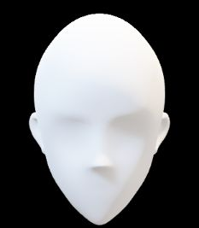



📖 Introduction – AttendX
Attendance is one of the most essential academic activities in schools, colleges, and workplaces.
Traditional methods like manual roll calls or ID card swipes are time-consuming, error-prone, and vulnerable to proxy attendance.
To overcome these challenges, we propose an AI-powered Attendance System that uses facial recognition technology.
Our system:
Captures live video through a webcam.
Detects and recognizes student faces using kerasfacenet.
Automatically marks attendance and stores it securely in a centralized database.
👉 This project aims to provide an accurate, secure, and efficient solution for managing attendance records while reducing manual workload.
Name : xyz Roll : 202410116100xxx

Slide 3

📖 Project Objectives
Automate attendance marking using facial recognition.
Build a secure, user-friendly web application.
Provide real-time recognition via webcam.
Maintain centralized records in a database.
Success measured by:
Recognition accuracy ≥ 90-95%
Reduced manual errors
Time efficiency compared to manual roll call

Slide 4
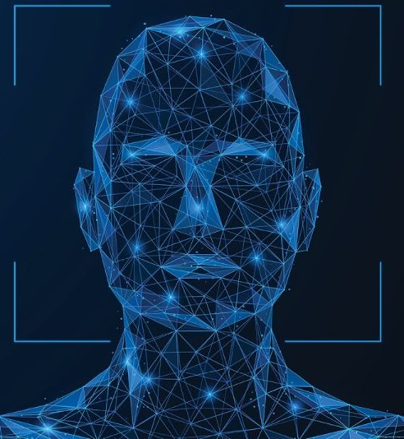
📖 Project Scope
✅ Included:
Registration of students with face images.
Live camera feed for attendance.
Database storage (student info + attendance).
Admin/teacher interfaces.
🔑 Key Features/Modules:
Registration Module
Attendance Module
Database & Security Layer
Reports/Exports

Slide 5

📖 SDG Level
SDG 4 (Quality Education): Ensures fair, accurate, and time-saving attendance in classrooms.
How Our Project Contributes
Accurate Attendance Tracking
Eliminates manual roll-calls and proxy attendance.
Ensures that only present students are marked, promoting fairness.
Time Efficiency for Teachers
Automates attendance in seconds, giving teachers more time to focus on actual teaching.
Improved Student Monitoring
Provides reliable records of student participation.
Helps identify irregular attendance patterns → early intervention for at-risk students.
Transparency & Accountability
Attendance data is stored securely in databases.
Prevents manipulation, ensuring equal treatment for all students.

Slide 6
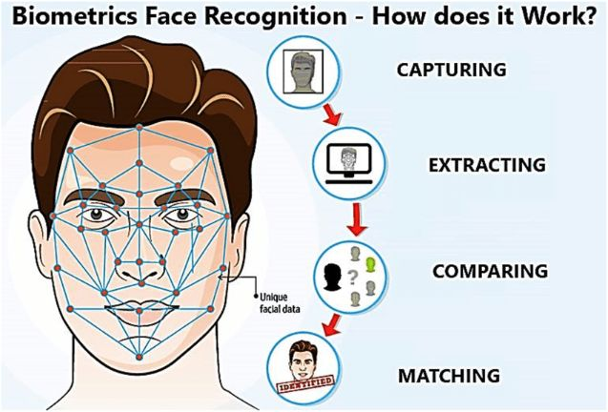
📖 Methodology
Development Approach: Agile (iterative development, continuous feedback).
Tools & Technologies:
Frontend: HTML, CSS, JS, Bootstrap
Backend: Spring Boot (APIs), MySQL
AI/ML: Python, OpenCV, kerasfacenet, TensorFlow
Security: Spring Security + BCrypt
Testing: Postman, Swagger

Slide 7
📖Technologies
Frontend Technologies Used
HTML – For structuring the content and layout of the web pages.
CSS – For styling, design, and responsive layout.
JavaScript (JS) – For dynamic behaviour and interactivity.
GSAP (GreenSock Animation Platform) – For smooth animations and motion effects.
Backend Technologies Used
Java (Spring Boot Framework) – For building the backend logic, REST APIs, and handling business operations.
Spring Data JPA (Hibernate) – For ORM (Object Relational Mapping) and easy interaction with the database.
MySQL – For storing user details, attendance records, and face registration data.
Spring Security – For authentication, authorization, and securing the APIs.
Maven – For project build, dependency management, and running the application.
REST API – For communication between frontend and backend (attendance marking, face registration, recognition).

Slide 8
📖 AI Part: AI-Powered Face Recognition
Technology | Purpose
OpenCV (cv2) | Captures live video frames and processes images for face detection.
NumPy | Efficient handling of numerical arrays and matrices for image data.
Keras-FaceNet | Pre-trained FaceNet model for extracting 128D/512D face embeddings.
Scikit-learn (SVM) | Trains a Support Vector Machine classifier on extracted embeddings for face recognition.
Workflow
Face Capture (via Camera)
OpenCV captures a live frame from the webcam.
User positions their face correctly for recognition.
Face Embedding Extraction
Input face image → FaceNet → numerical embedding representing unique facial features.
Model Training
SVM classifier learns to classify embeddings as specific individuals.
Prediction
New face → embedding → SVM predicts the person’s identity and sends data to backend.

Slide 9
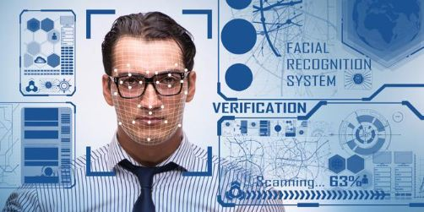
📖 System Architecture
Webcam
OpenCV
DeepFace
(CNN)
Embeddings
DataBase(MySQL)
API (Spring Boot)
Attendance Report

Slide 10


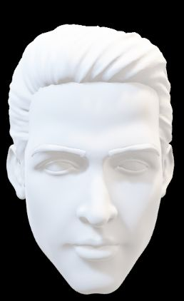
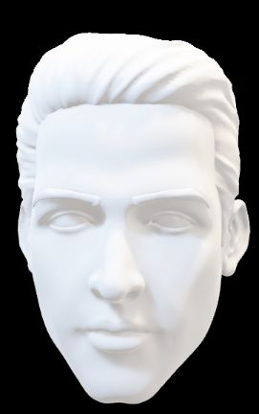
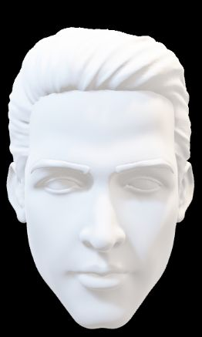
📖 AttendX
Create a Cascade classifier, It will contain the features of the face
Input Image
Displayed Image
OpenCV will read the input and the feature file
Name – xyz
Roll no – 202410116100xxx

Slide 11
📖 Project Outcome
Web Application Development – Attendance system using AI + Spring Boot + MySQL.
Demonstrates real-world application of AI/ML in academics.
Future scope: Advance analytic Dashboard, Multi Campus Integration.
GANTT CHART
PHASE | Week 1 | 2 | 3 | 4 | 5 | 6 | 7 | 8 | 9 | 10 | 11 | 12 | 13 | 14 | 15 | 16 | 17 | 18
Requirement Analysis & Planning | ████ | ████
System Design |  |  | ████ | ████
Dataset Preparation |  |  |  |  | ████ | ████
Model Development |  |  |  |  |  |  | ████ | ████ | ████
Integration & Backend Development |  |  |  |  |  |  |  |  |  | ████ | ████ | ████
Frontend Development |  |  |  |  |  |  |  |  |  |  |  |  | ████ | ████
Testing & Debugging |  |  |  |  |  |  |  |  |  |  |  |  |  |  | ████ | ████
Deployment |  |  |  |  |  |  |  |  |  |  |  |  |  |  |  |  | ████
Documentation & Reporting |  |  |  |  |  |  |  |  |  |  |  |  |  |  |  |  |  | ████

Slide 12
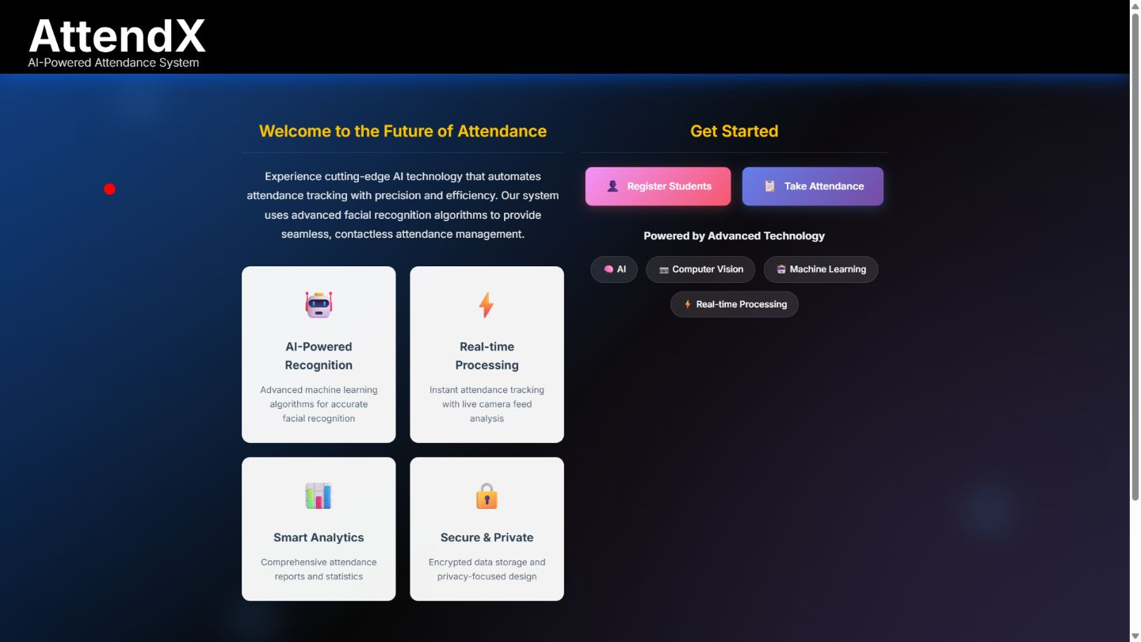

Slide 13
📖 Conclusion
The Attendance with Facial Recognition system provides a modern, reliable, and efficient solution to replace manual attendance methods.
By combining AI-based face recognition (Keras Facenet, CNNs) with a secure web backend (Spring Boot + MySQL), the project ensures accuracy, speed, and security.
It eliminates proxy attendance, human errors, and time delays, making the process automated and transparent.
The system demonstrates the real-world application of AI/ML in education and workplace environments.
With future enhancements like dashboards, mobile app integration, and analytics, the system can evolve into a comprehensive smart attendance platform.

